Slide 1

P1 Project Introduction to Hive
Members:
Jason McClintock Jessica Hori
Shawn Sampson
Notes:
Good afternoon, everyone. Welcome to our P1 presentation. My name is Jessica Hori and joining me today are my colleagues Jason McClintock and Shawn Sampson as we give you a short introduction to Hive.

Slide 2
What is Apache Hive?
Software utility built on top of Hadoop for easy data query and data analysis.
Why do we need it?
Built as an answer for querying large datasets that traditional Relational Databases do not handle. Transforms HiveQL queries into MapReduce jobs.
Notes:
What:
SQL-like interface and syntax to query data from many types of databases and file systems that are integrated with Hadoop.
Why:
Potential use cases: data mining, document indexing, predictive modeling, business intelligence

Slide 3



Questions and Dataset
User with the highest average rating for a specific year
Top 25 ranking movies for a specific year
Top 25 rated movies having at least 100 views.
Notes:
We are using a data set from Movielens.org. We are using a 100k sample but they also have datasets up to 25 million records, which would need multiple computers to run.
The records were collected between 1997 - 1998 and includes records before and up until that time period. We will look at the data and answer these 3 questions: List questions….
I have included pictures here as a preview to what we might find in the answer.

Slide 4
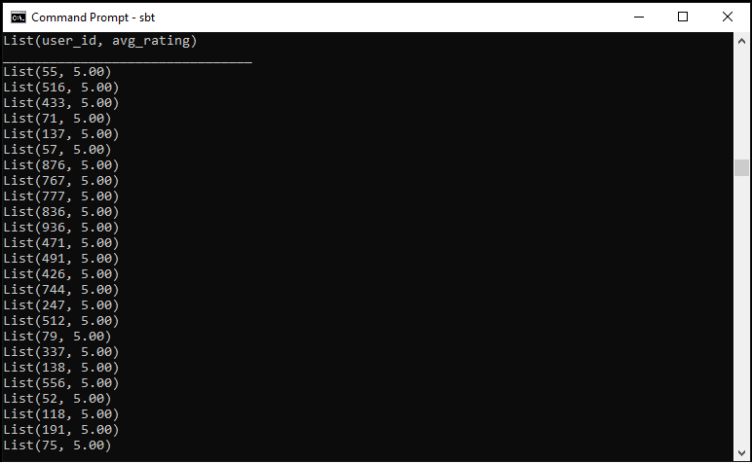


User with the highest average rating for a specific year
Hive command: SELECT user_id, avg_rating FROM ( SELECT user_id, CAST(AVG(rating) AS DECIMAL(10,2)) AS avg_rating FROM ratings INNER JOIN movies ON ratings.movie_id = movies.movie_id WHERE movies.release_date RLIKE '.*(1993).*' GROUP BY user_id) tmp ORDER BY avg_rating DESC LIMIT 25
Result: 5 was the highest average rating for 1993
Why are we looking for this data?
To figure out how users rate their movies, to look at trends on whether they only give high or low ratings too frequently, whether they are balanced raters.
What can it be used for?
To determine the quality of movies for a given year. If you compare the ratings across years, you can compare the quality of movie releases based on viewer input.
55|37|M|programmer|01331
Phillipston, MA
777|63|M|programmer|01810
Andover, MA
Notes:
We used nested queries on this guy, in order to get the highest ratings for the year 1993. We came up with several users who had 5s as average ratings.
So, I wanted to see who these users are and I chose 2 random numbers in the list. 55 and lucky 777. It turns out, these are coincidentally 2 programmers in MA.
Why are we looking at this data? …. SLIDE
Expansion:
Going deeper, we could check the genres and see which type are their favorites or if they have a wide range of favorites across many genres
What can it be used for? … SLIDE
Expansion:
Ratings take into consideration storyline, visuals, acting abilities. Many times, fans of today state that movies aren’t how they used to be. Using solid data, you can determine if this is true or not.
Now I will hand you over to my colleague Jason. Who will talk to use about our next data set.

Slide 5
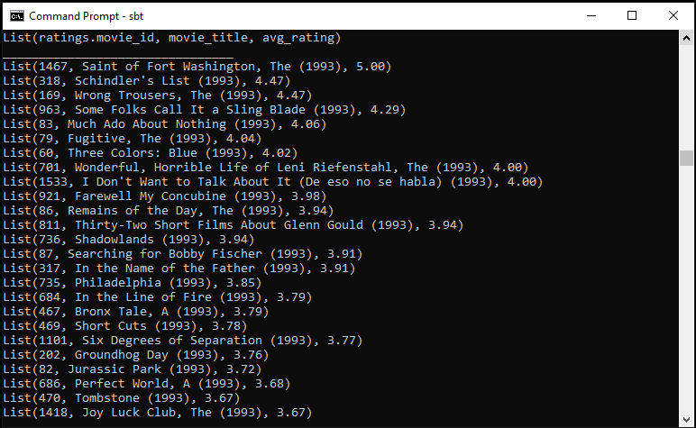
Top 25 ranking movies for a specific year
Hive command: SELECT movie_title, CAST(AVG(rating) AS DECIMAL(10,2)) AS avg_rating FROM ratings INNER JOIN movies ON ratings.movie_id = movies.movie_id WHERE movies.release_date RLIKE '.*(1993).*' GROUP BY ratings.movie_id, movie_title ORDER BY avg_rating DESC LIMIT 25;
Result: Jurassic Park and Groundhog Day are notable titles
Why are we looking for this data?
To narrow down the best movies in a given year. You can compare trends across specific years.
What can it be used for?
To get suggestions of films to watch for the year without having to go through many to find ones you like. Additionally, film makers can know what kind of movies were popular, such as storylines and genre to potentially inspire future work.

Slide 6
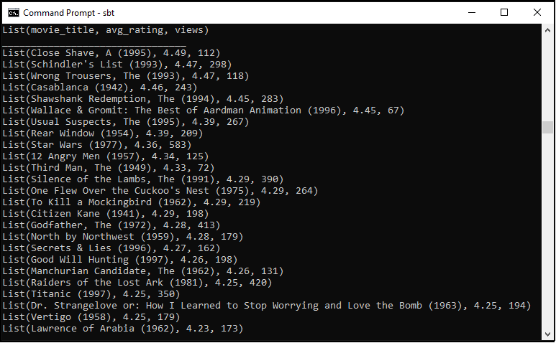
Top 25 rated movies having at least 100 views
Hive command: SELECT movie_title, avg_rating, views FROM (SELECT movie_title, CAST(AVG(rating) AS DECIMAL(10,2)) AS avg_rating, COUNT(rating) AS views FROM ratings INNER JOIN movies ON ratings.movie_id = movies.movie_id GROUP BY ratings.movie_id, movie_title ) tmp WHERE views >= 100 GROUP BY movie_title, avg_rating, views ORDER BY avg_rating DESC, views DESC LIMIT 25;
Result: Star Wars, The Godfather, Titanic and Silence of the Lambs are notable titles
Why are we looking for this data?
To check ratings with a minimum viewer rate to get adequate rating data.
What can it be used for?
This is used to get the top ratings for all movies in the database. Using this data, you can determine not only the most popular movies for viewers, but you can use this for movie screenings as you are bound to find something that attendees can agree with.

Slide 7
Questions?

